Slide 1

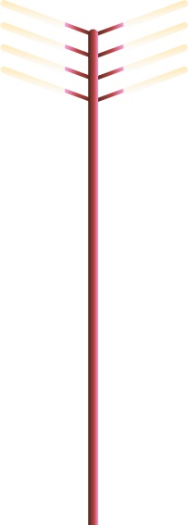
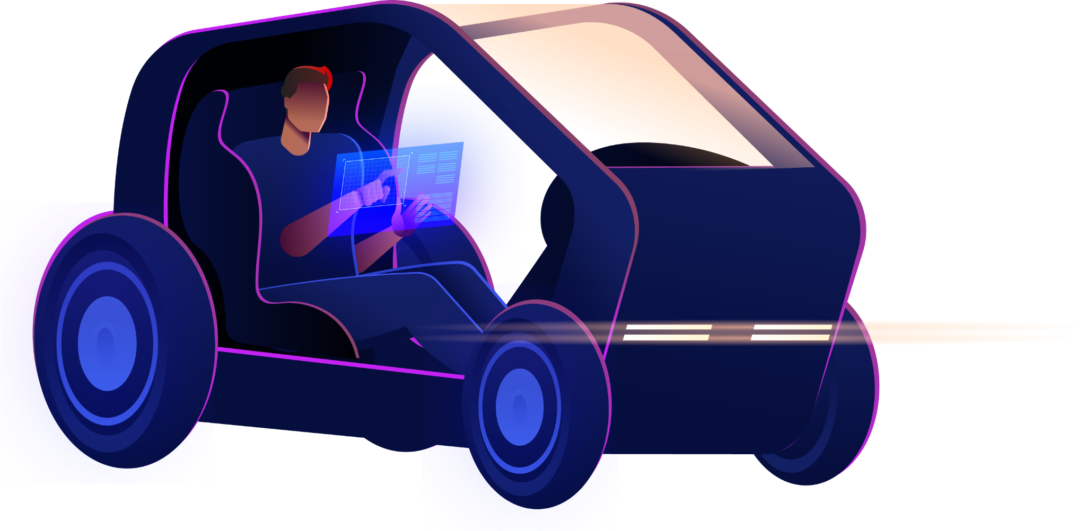


Obstacle Avoiding and Auto-Parking Car

Slide 2



Team Members
Amany Fathy
Hagar Tarek
Loreen Mohamed
Sama Ahmed
Nada Mohamed

Slide 3
Table of contents
01
04
02
05
03
06
Problem Description
Flowchart
System Design
Cost Analysis
Solution Implementation
Conclusion

Slide 4



01
Problem Description

Slide 5
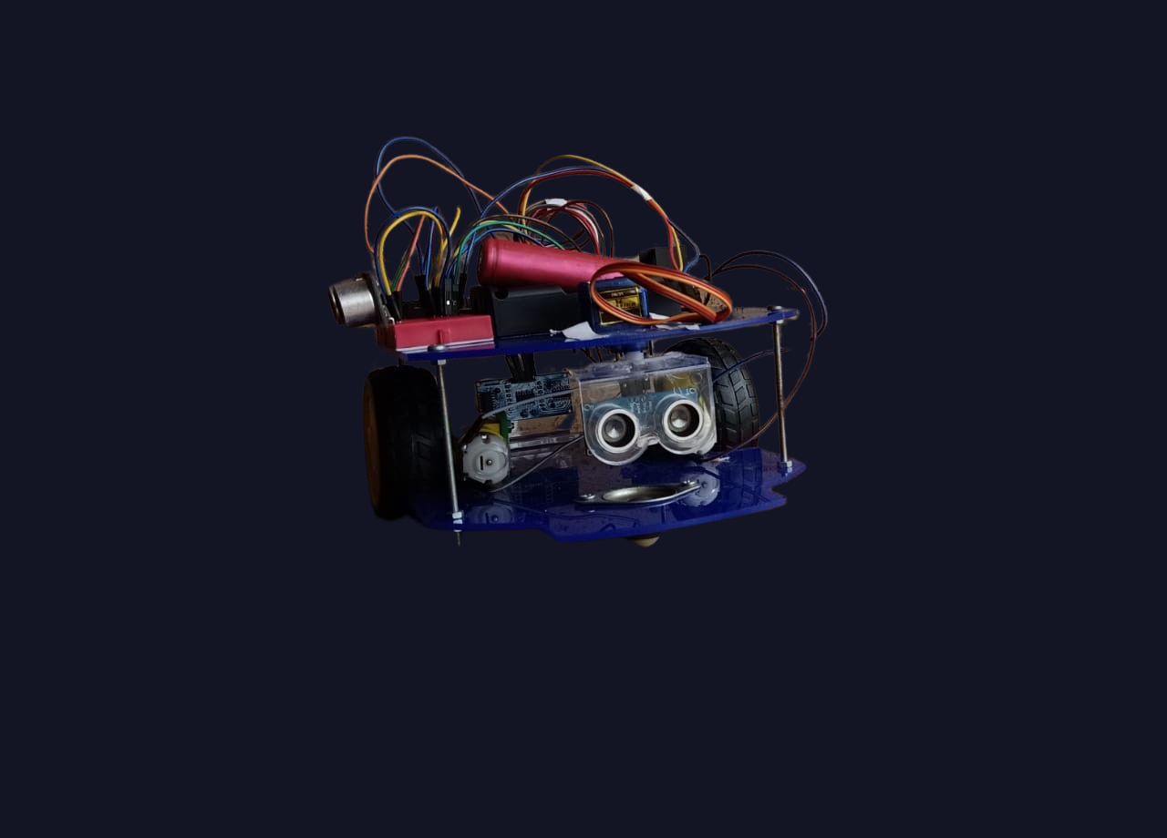

Problem Description
The car industry is one of the leading industries that has changed due to automation, with automation levels ranging from level 0 (no automation) to level 5 (fully autonomous cars).
Our objective was to design and implement an autonomous robot capable of avoiding obstacles and auto-park itself, making it a level 2 automation, partially automated.
The problem was implementing such an idea using non-industrial components, like an Arduino Uno board and a simple H-bridge motor driver.

Slide 6
Challenges Faced in Tasks
Obstacle Avoidance
Auto-parking
Choosing the best sensor to detect the presence of obstacles without adding unnecessary cost.
Choosing the best path to continue driving on when an obstacle is found.
The number of sensors needed for optimal parking.
The challenges of parallel parking differ from those of perpendicular parking.

Slide 7
02
System Design

Slide 8
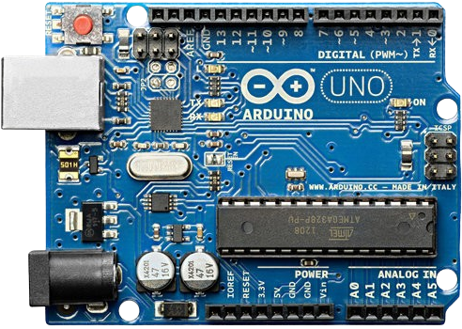
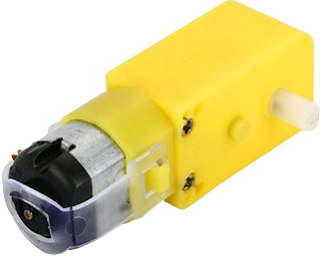

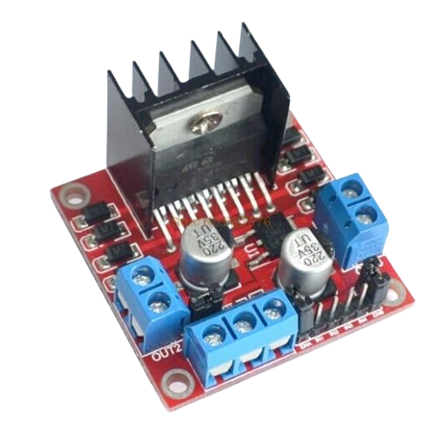
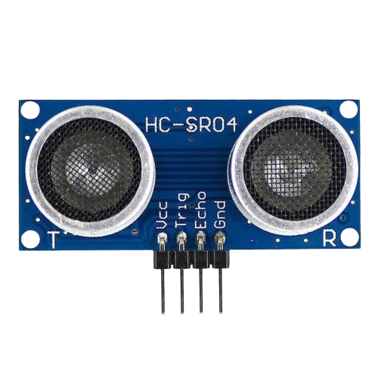
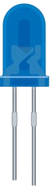
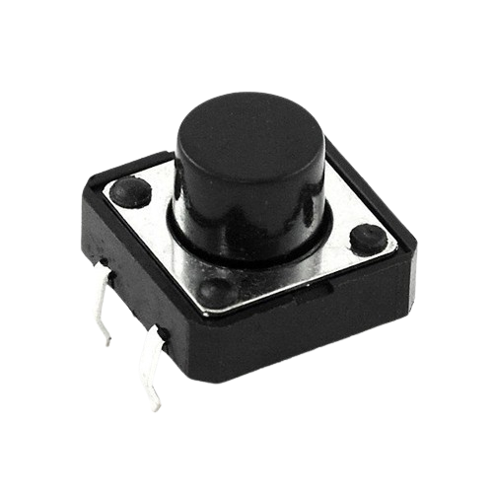
System Design
Arduino Uno
Motors
Microcontroller
Allow car to move
H-bridge
Ultrasonic Sensor
Integrated Circuit
Measure distance to obstacles
Led
Button
Indicate activating the parking mode
Mode switching

Slide 9
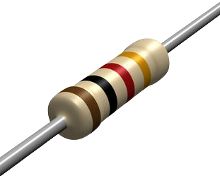
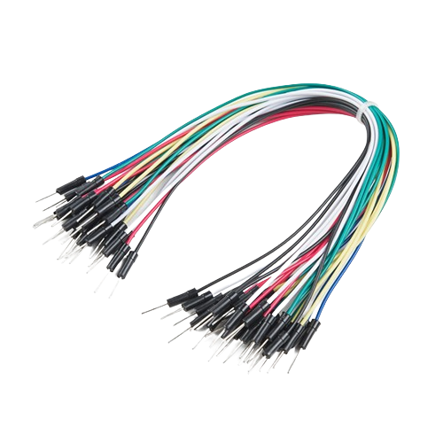
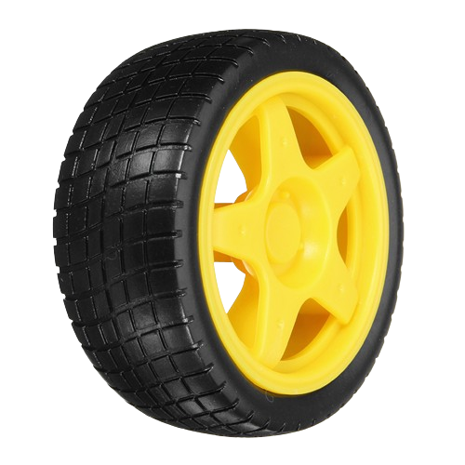
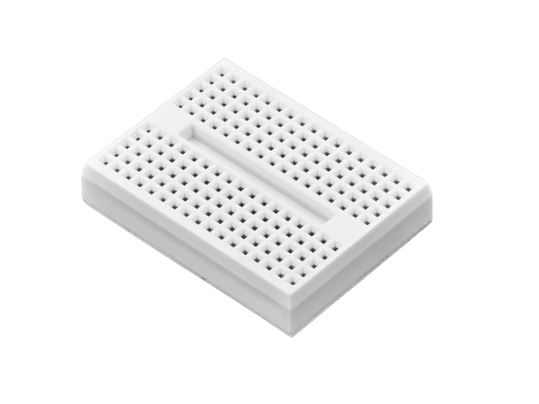
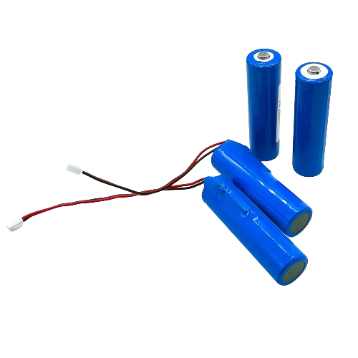
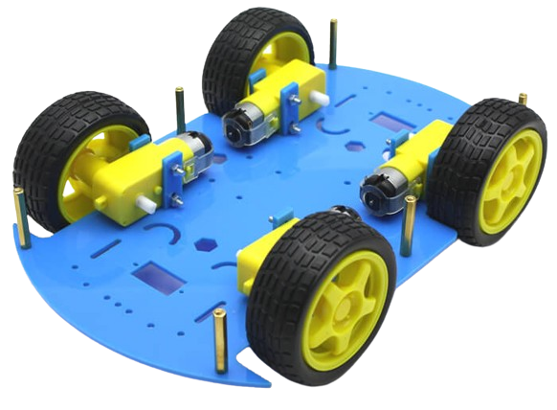
System Design
Resistor
Jumper Wires
Lower voltage
For electrical connections
Wheel
Breadboard
Move car from point to another
Reconfigurable Platform
Lithium Battery
Car Body
Power Supply for the system
Physical Structure

Slide 10
03
Solution Implementation

Slide 11
Obstacle Avoidance
Sensor Integration and Obstacle Detection
Autonomous Navigation and Path Planning
Obstacle Avoidance
The front ultrasonic sensor is attached to a servo, so it can turn around 180 degrees to check for any obstacles and find a clear path to drive on.
We used the NewPing library in Arduino to interface with ultrasonic distance sensors.
The obstacle avoidance logic is integrated into the car's movement, allowing it to adjust its path dynamically based on the detected obstacles.
`obstacle_avoid()` function is responsible for handling the obstacle avoidance logic.
It starts by reading the distance from the ultrasonic sensor using the `readPing()` function.

Slide 12
2. Auto Parallel Parking
Sensor Integration
Parking Spot Detection
Parallel Parking Strategy
Solution relies on ultrasonic sensor readings.
Three ultrasonics : Front, Back, and Side.
We used the Ultrasonic library on Arduino to work with ultrasonic distance sensors.
`Check_Parking_Spot()` is responsible for detecting the parking spot and confirming its dimensions.
Front and side ultrasonic sensors are used to gather distance information.
`Find_Park()` coordinates the parallel parking strategy.
The parking status is 3, meaning that the parking spot is available, so the car is stopped, and the parking status is set to 4 (start parallel parking).

Slide 13
04
Flowchart

Slide 14
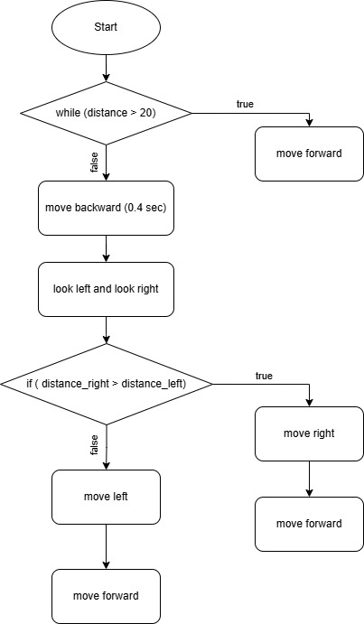
Obstacle Avoidance

Slide 15
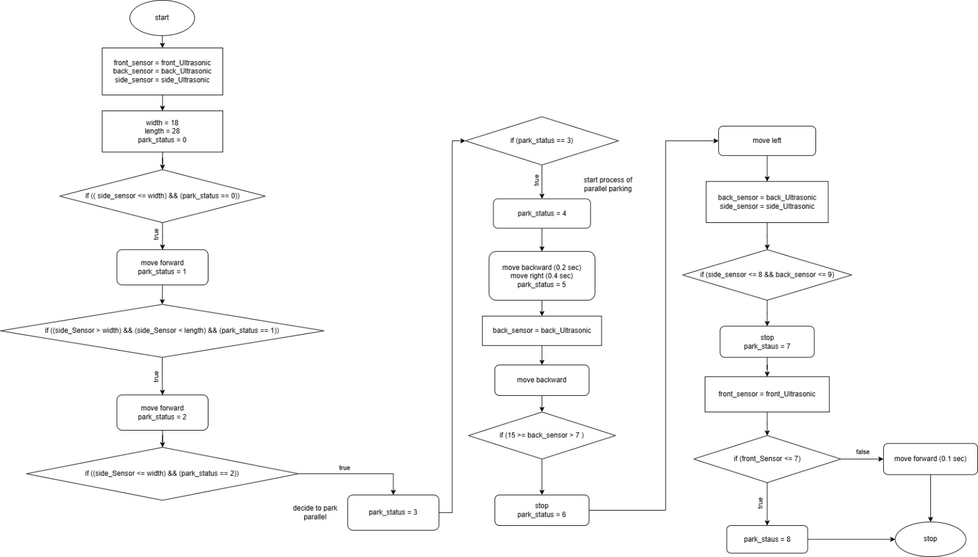
Parallel Auto-parking

Slide 16
05
Cost Analysis

Slide 17
Cost Analysis
Component | Units | Unit Price | Total Price
Car Body | 1 | 200 | 200
Arduino UNO | 1 | 465 | 465
Bread Board | 1 | 15 | 15
Jumpers | 32 | 1 | 32
Ultrasonic Sensor | 3 | 45 | 135
US Holder | 2 | 15 | 30
Lithium Battery | 2 | 65 | 130
Component | Units | Unit Price | Total Price
Battery Holder | 1 | 21 | 21
H Bridge | 1 | 90 | 90
Servo | 1 | 110 | 110
Resistor | 1 | 0.5 | 0.5
Button | 1 | 2.5 | 2.5
Free Wheel | 1 | 35 | 35
Led | 1 | 1 | 1

Slide 18
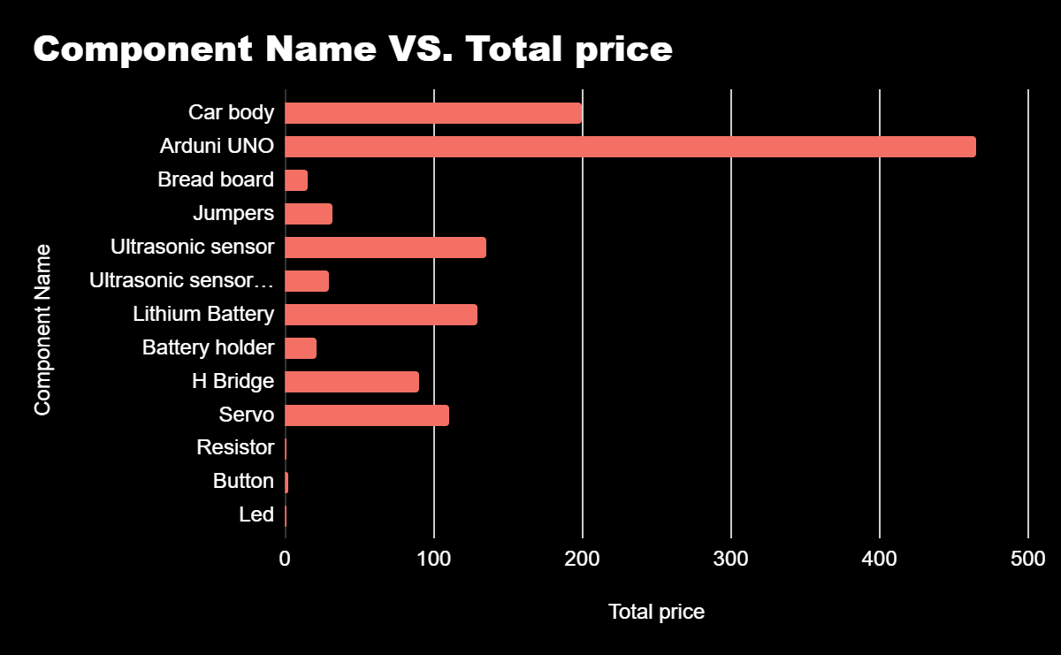
Cost Analysis
The total cost of 1,267 EGP for the autonomous car system is an appropriate and justified cost for the following reasons:
The selection of each component was carefully considered to balance functionality, performance, and cost-effectiveness.
By choosing cost-effective yet reliable components, such as the Arduino Uno, ultrasonic sensors, and basic electronic parts, the project was able to keep the overall cost at a reasonable level.

Slide 19
Ultrasonic Sensor or Camera ?
In this project, the decision was made to use three ultrasonic sensors instead of a camera-based system. WHY ?
Cost
Simplicity
The camera’s cost is estimated to be 800 EGP, while the three ultrasonic sensors together cost 135 EGP, so we were able to save about 665 EGP.
Ultrasonic Sensors are generally more affordable.
Camera-based systems often require more complex image processing and algorithms, which can increase the overall complexity and cost of the project.
Ultrasonic sensors provide direct distance measurements

Slide 20


Task Videos

Slide 21
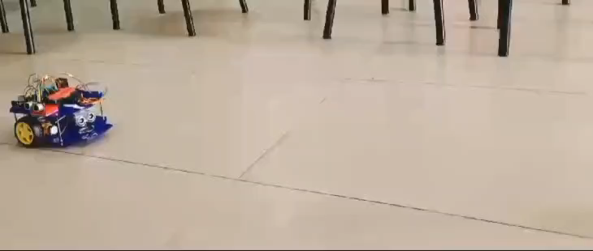
Obstacle Avoidance

Slide 22
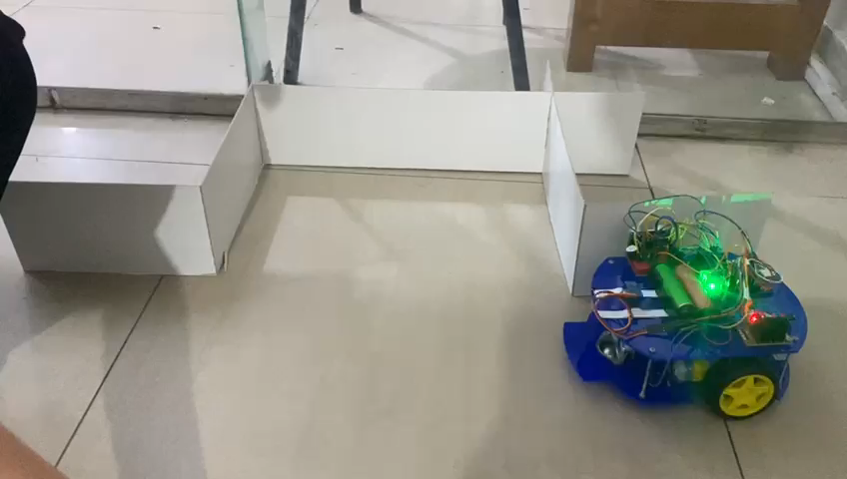
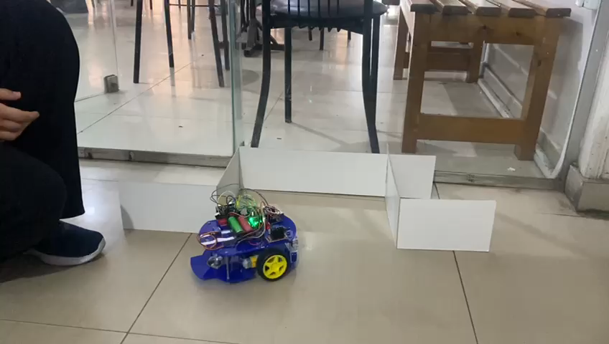
Parallel Auto-Parking

Slide 23
06
Conclusion

Slide 24
Coclusion
In conclusion, our autonomous car project, which focused on object avoidance and parallel parking, successfully met its goals and objectives through the effective use of embedded systems. By integrating ultrasonic sensors, we enabled the car to accurately perceive its surroundings, ensuring reliable detection of obstacles and precise execution of parallel parking strategies. The seamless interaction between hardware components and software algorithms demonstrated the viability of ultrasonic sensor technology in enhancing the capabilities of autonomous vehicles.

Slide 25
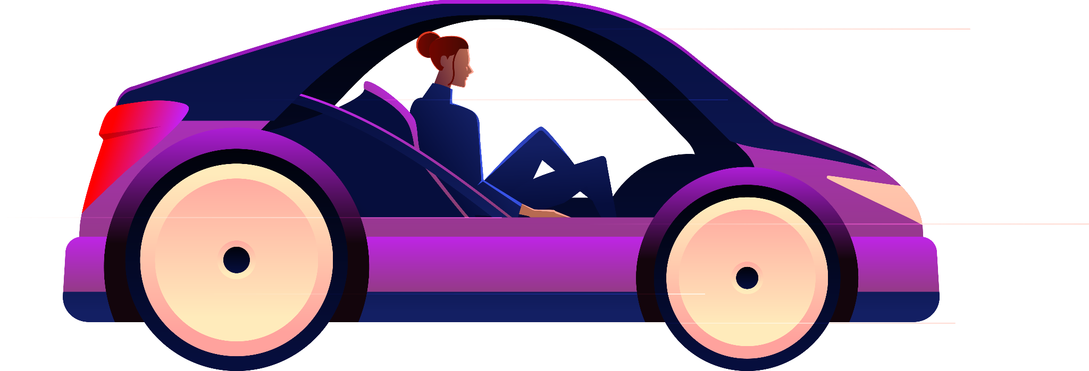
Thanks !

